Slide 1
SECURED MEDICAL TRANSCRIPTION USING BLOCKCHAIN
Gowtham prasad s, 17mss018

Slide 2
System Specification
HARDWARE SPECIFICATION
• Processor - Intel® Core™ i5-2450M CPU@2.50GHz
• Installed Memory (RAM) - 4.00GB
• System Type - 64-bit OS, x64-based processor
• Storage - 500GB HDD
SOFTWARE SPECIFICATION
• Operating System - Microsoft Windows 10 Pro
• Editor - Microsoft Visual Studio Code

Slide 3

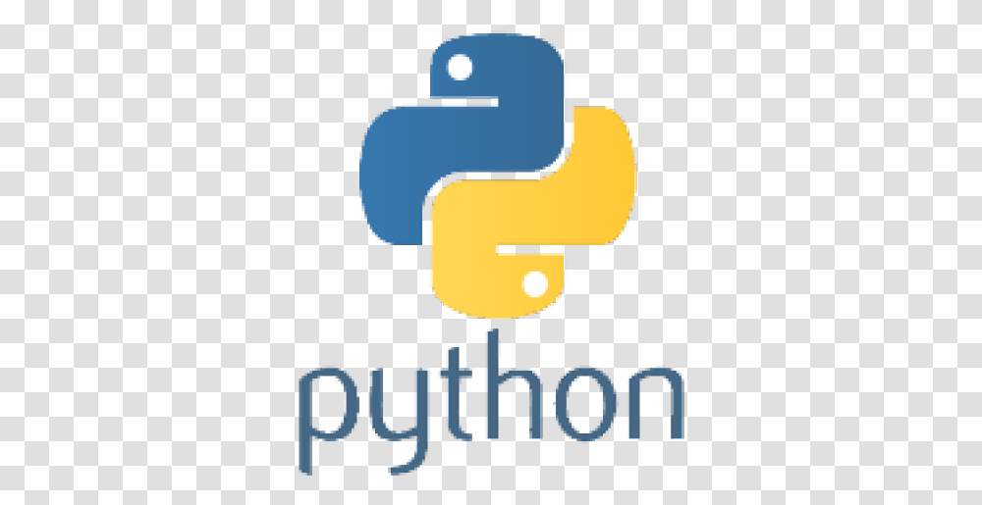
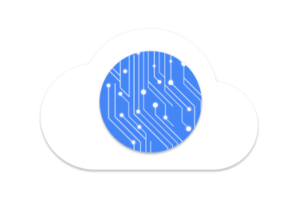
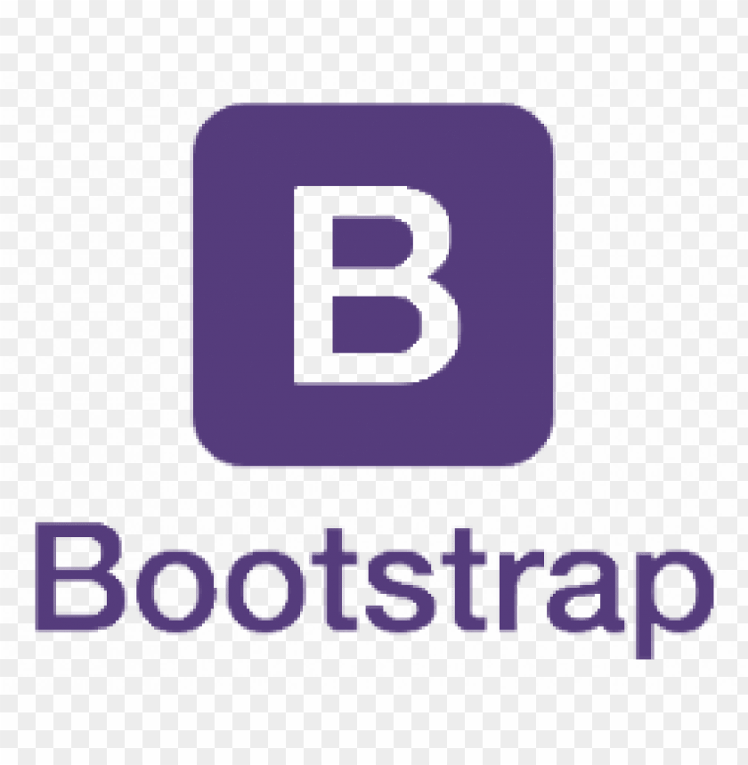


Tools, Frameworks, Libraries

Slide 4
System Study
EXISTING SYSTEM WITH LIMITATIONS
Medical transcription (MT) is the manual processing of voice reports dictated by physicians and other healthcare professionals into text format. Medical data are sent to third party organization for medical transcription. Since data are passed through third party, there is a possibility of breach in medical records. Humans make errors, mistakenly misunderstand some words and it may affect the quality of the medical report. Medical transcription companies are paid extra to complete the process as soon as possible.

Slide 5
System Study
Limitations
Voice reports that are sent to third party organization for medical transcription process has high risk of confidentiality breach.
Usually, it takes hours of typing to complete one medical record.
This is an expensive process and a time-consuming task.

Slide 6
System Study
PROPOSED SYSTEM WITH ADVANTAGES
To reduce time and money, the medical transcription process can be automated using SpeechRecognition API, which converts voice reports into text format. The goal of blockchain is to allow digital information to be recorded and distributed, but not edited. In this way, a blockchain is the foundation for immutable ledgers, or records of transactions that cannot be altered, deleted, or destroyed. The medical record is stored across the distributed network as blocks and combined together.
This solution is deployed as web application using Flask web micro framework. This process is completed within 5 minutes thus saving enormous amount of time and money.

Slide 7
System Study
Advantages
Since SpeechRecognition API is used to automate the medical transcription, time and money can be reduced.
Medical records are securely stored in Blockchain thus making it impossible for any confidentiality breach.
It will be deployed as a web application, so it makes it easy for the doctor and patient to access the medical record whenever required.

Slide 8
Thank You!

